Slide 1
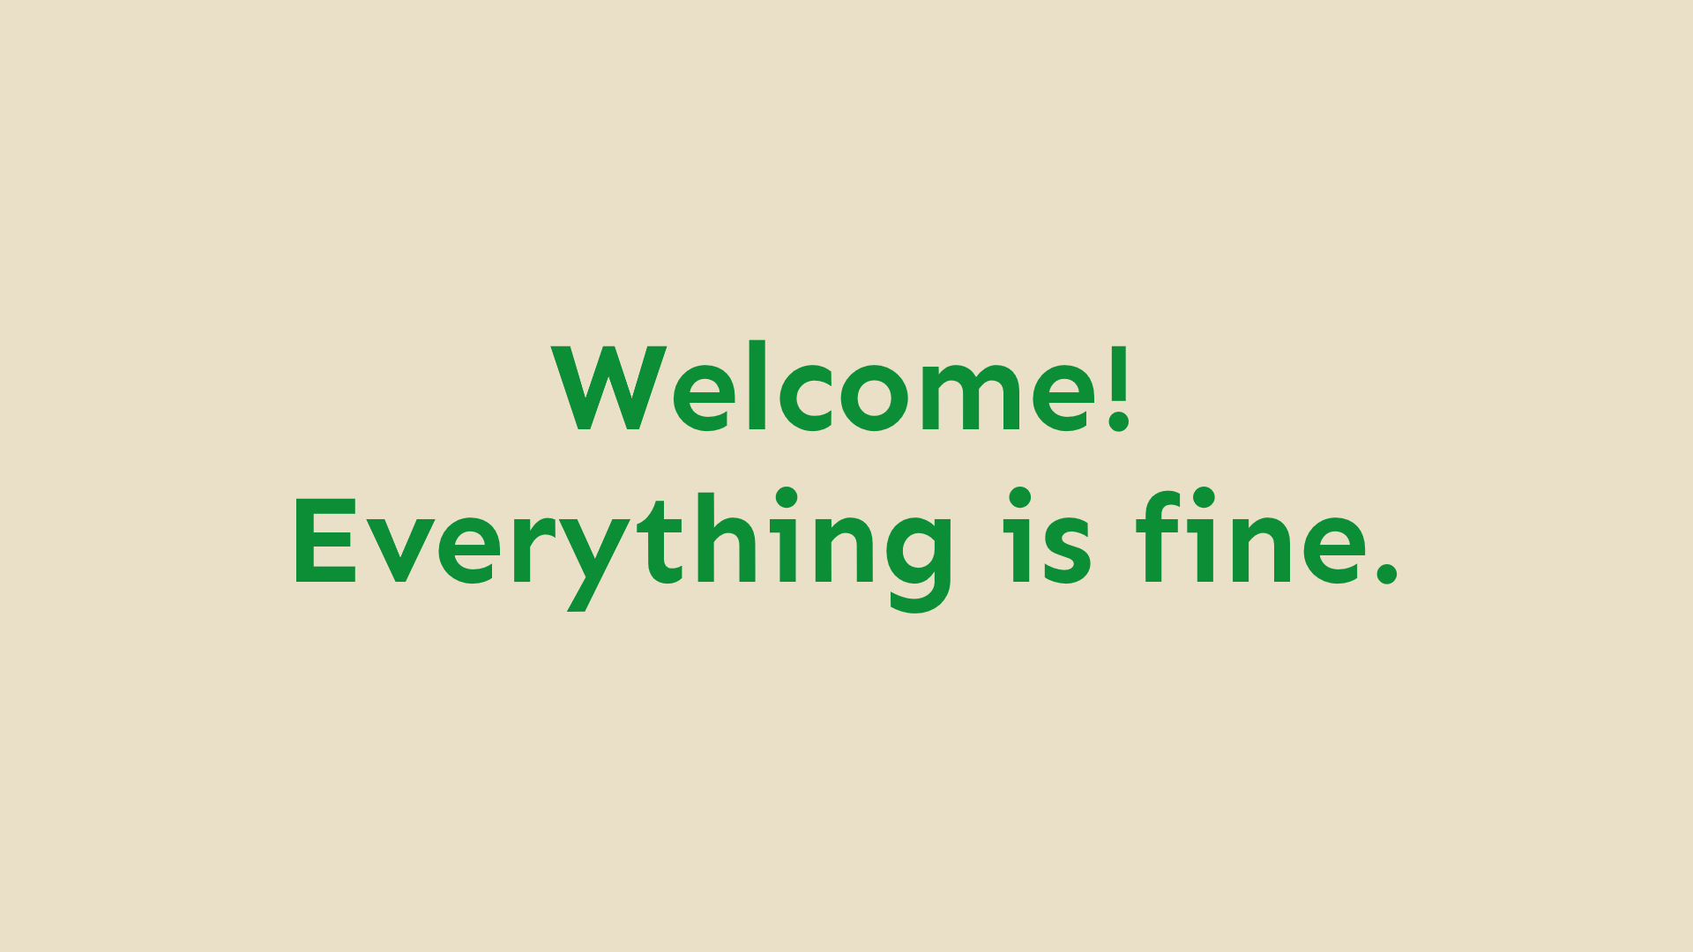

Slide 2
Introduction to Git
Chris Hammond: chris@ucl.ac.uk
It’s an introduction to me. I am the Git. Introduction over. Ish.
Laptops out if you already have Git installed. If not, that’s fine and you can just enjoy my dashingly good looks presentation
Notes:
We kindaaaa screwed up a bit. The Git installed assistance is tomorrow at Set Up Your Environment so if you don’t have Git installed then that’s ok and you can give this a go tomorrow. If you already do have it installed then do join it but also please show the people around you so that they can give it a go when they have their laptops.
Two minute breather??

Slide 3
What is git (except a funny sounding word)
Git is a Version Control System (VCS)
It’s basically the standard for making code changes, collaborating with code and synchronising your local copy of your code with a website (like GitHub)
Open Source
Originally created for the Linux kernel, but it’s so good that even Microsoft is now using it for Windows
(Mostly Inferior) alternatives include Subversion (SVN) and Mercurial (Hg)
Almost every programming job will expose you to Git at some point, and it will help you collaborate.
Highly desirable and important skill

Slide 4
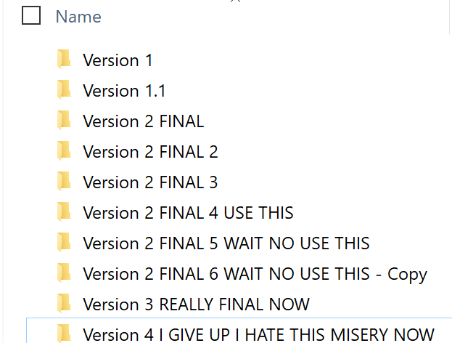
The old way
No idea who changed what
If you synchronised this with Google Drive, OneDrive or Dropbox and two people changed the same file at once the world would implode and space-time would rip (sort of)
Unmaintainable and unwieldly
What if somebody wanted to try a new idea or propose some changes?

Slide 5
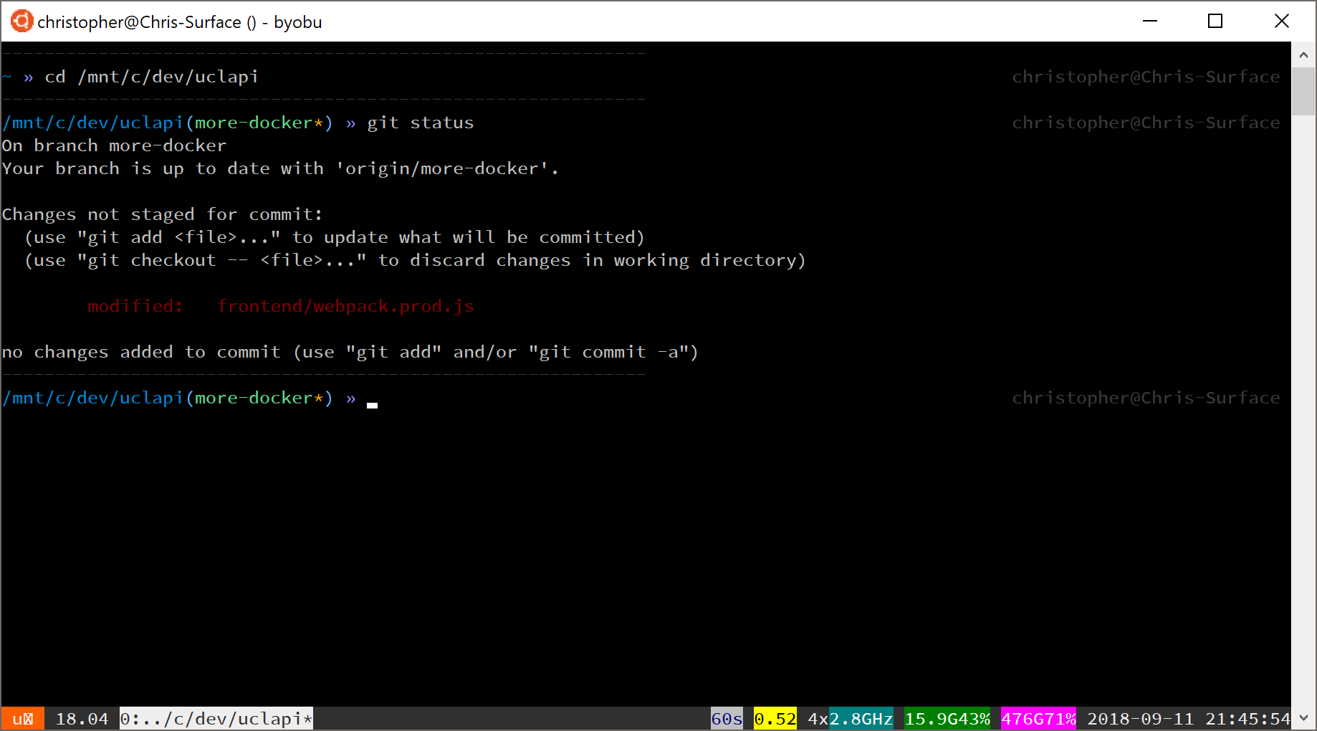
The Git Way (nerdier but way better)
Branches (so you can go off-piste without screwing your team-members over)
Proper tracking of what has changed
Project folder

Slide 6
Git is all about changes (upon changes upon changes upon changes)
Each change is called a commit
Each commit contains some changes made to the project, e.g.:
A file was added
A file was deleted
A line was added to a file
A line was deleted from a file
Some permissions were changed on a file
When you edit files managed by Git, you view the result of chaining all these commits together to reach the version you are on now. This is called the HEAD, and it points to the version of the code you are working with as of that commit.
You can also branch off and make changes separately, so you can work on individual features independently. Here’s a pretty picture!

Slide 7
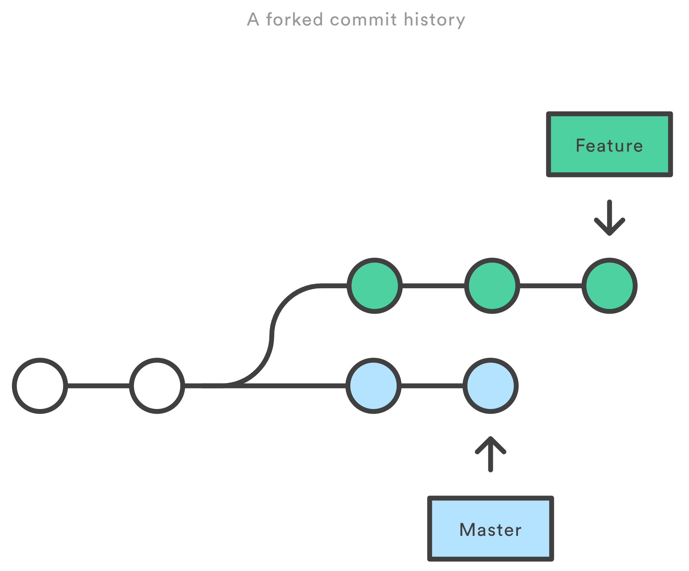
In this scenario
Each commit is a set of changes somebody has made.
At some point a developer decided to experiment by creating a new branch for the feature, and adding commits to it.
At some other point, some other developer(s) have pushed some commits to the master branch. As the two branches have deviated, there is no need for the feature developer to worry about these new changes in master. Not until they need to merge, anyway!
Each circle is a commit (i.e. a set of changes to the project)
Branches
Notes:
Every project by default has a “Master” branch where the code goes. If you then want to develop a separate feature, fix, etc. you can create a branch which is like a fork in the road, and add all your changes to it after. Each branch can have commits added to it separately. When you are happy with your feature you can “merge” those commits back into master.

Slide 8
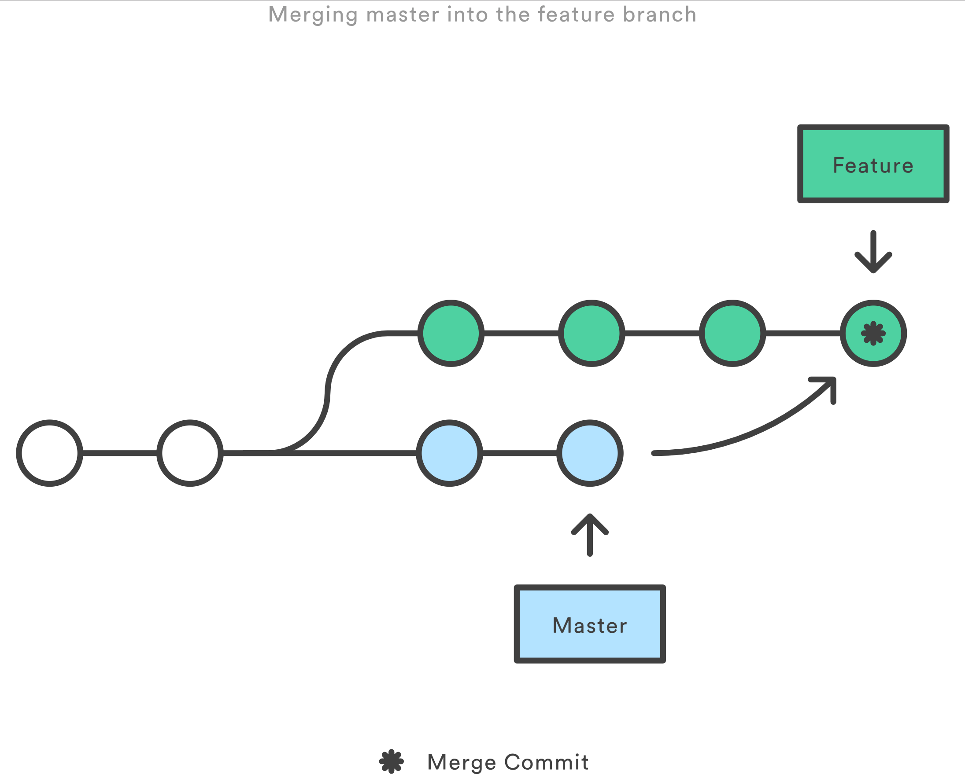
In this scenario
The master (main) branch has been updated with some new functionality, and the feature branch has some new code too.
The feature developer has realised that the updates in master are super important, and wants to be able to take advantage of them.
The master branch is merged into the feature branch using what’s called a ‘merge commit’
Now the feature developer has all the latest master code, as well as all the new code they wrote for some new feature.
When the feature is complete, the extra commits can be merged into master in the same way, then the branch can be deleted.
Notes:
Now, what if those updates in master are important, and the feature developer needs them? The git merge command can solve this by creating a so-called ‘merge commit’, which takes all those changes in master and brings the feature branch up to date with it. This works even if developers have edited the same files, because it works line by line.
There is another way of doing this called Git Rebasing. This lets you maintain the commit history verbatim but it’s more complex and I won’t go into it now as it requires forcing certain changes to be made and the rewriting of history, neither of which I want to go into now.

Slide 9
Some commands
Before we do this in practice, there are some commands you should know. The ones in bold are super duper important.
Command | Explanation | Command | Explanation
git add | ‘Stage’ a changed file ready to be committed | git commit | Take all added ‘files’ and create a commit ready to be pushed
git push | Take all new commits and put them on the server | git pull | Take all the new changes from your team and get them locally so you can see and work with them
git merge <branch> | Merge all the changes from <branch> into the branch I am currently working in | git clone <path> | Take a copy of all the code at <path> and download it locally for use
git reset | Help!! I accidentally added something I shouldn’t have. Don’t delete anything, just un-add what I’ve done so far | git checkout <branch> | Switch to another branch
git branch | What branch am I working in now? | git checkout -b <branch> | Create a new branch and switch to it now
Notes:
I’ll introduce the commands then show you an example of how this works!

Slide 10
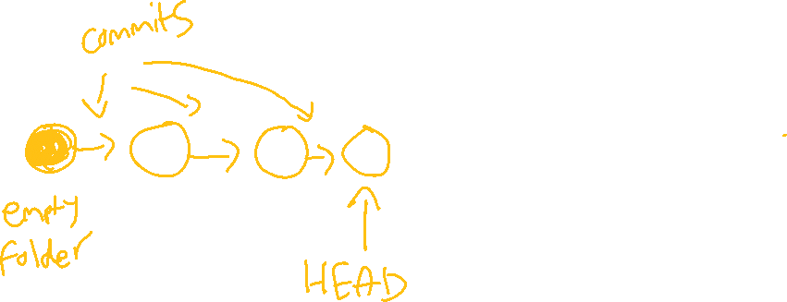
A day in the life of a change

Slide 11
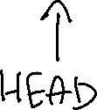
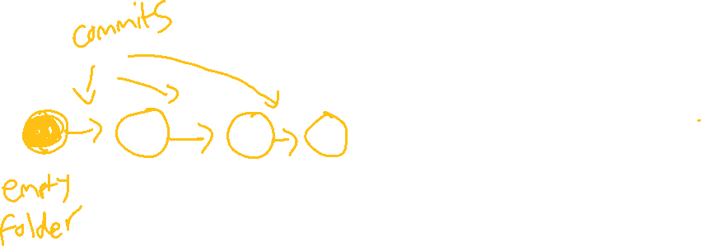

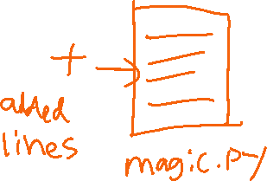

A day in the life of a change

Slide 12
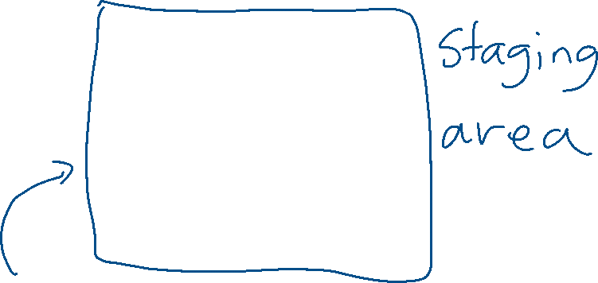
A day in the life of a change
git add magic.py

Slide 13

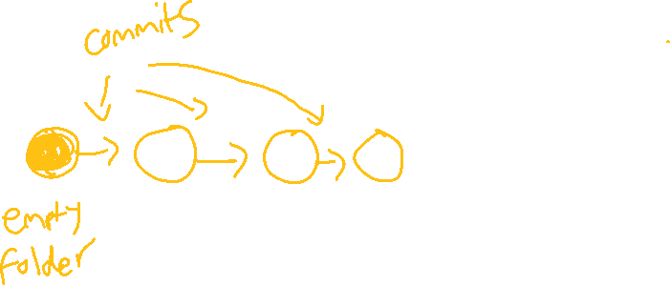
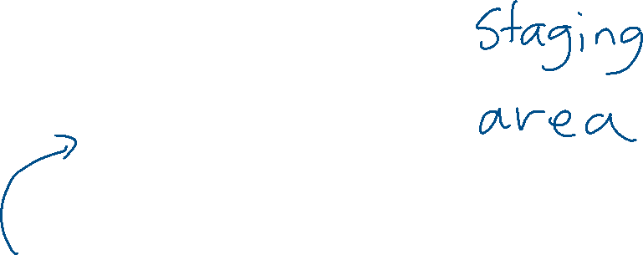

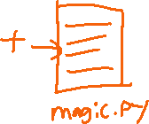
A day in the life of a change
git add magic.py git add hello.jpg

Slide 14

A day in the life of a change
git add magic.py git add hello.jpg
git commit

Slide 15

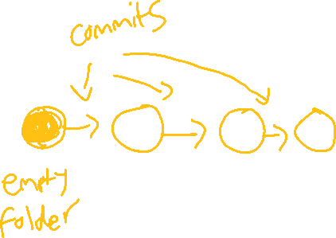





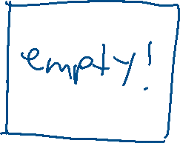
A day in the life of a change

Slide 16
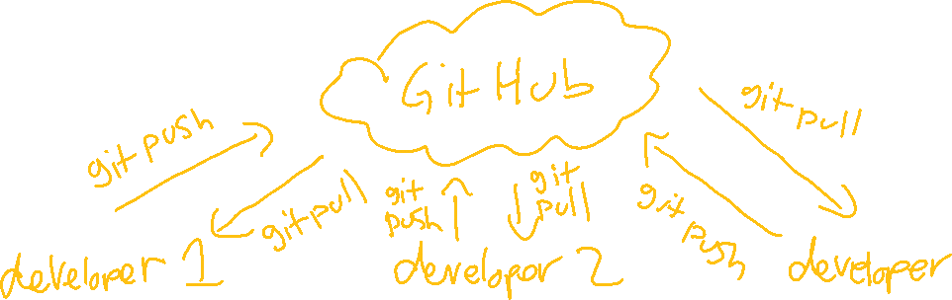
Ready to share your changes with your friends?
git push will upload your change back to where you got the code from originally (“the remote”). For example, this may be a GitHub repository
git pull will look on the server for new commits from fellow developers. If there are more they will be downloaded.

Slide 17
Pull Requests and forking (not in the context of freshers week)
Forking: taking somebody else’s code repository and making a copy you can work on
Pull Requests: “hey, I made this change, could you please merge it into your version?”
Used for contributing to projects you are not an owner of
See an Open Source project and you want to help? Fork it, make the changes then submit a Pull Request

Slide 18
The Guest Book
https://github.com/Porticode3/Guestbook
Markdown (basically text, plus some symbols to add basic formatting)
I’ll add my name, then each person should:
Fork the repository (to make their own copy)
Clone it (to work on it locally)
Create a branch (to add the changes without conflicts)
Add the changed Welcome.md file (to stage it)
Commit the change (to get it ready to make available)
Push the change (so that it is on the internet)
Make a Pull Request ready for me to merge (so your change can come to me)
Notes:
This looks like a lot of steps! I’ll do it first as a demo. If you can’t do it today then that’s fine, because you might not have the tools yet.
Once you have the tools in place and you manage to add your name to the guestbook I’ll merge it in. NOT assessed / examined / etc. Just a small, basic introduction to Git.
If you have any issues with it after we do the environment setup tomorrow then try and help each other (there’s 180 of you!) and if you still have problems then feel free to contact me and I’ll help.

